Slide 1
Digital Entrepreneurship for Adult Learners
Training module title:Online Content Creation - How to create your online presence
By Internet Web Solutions.

Slide 2
INDEX
Unit 1. Online content creation. Taking your business online.
1.1 Creating quality content
1.2 Website / blog / online store
Website
Blog
Online store
1.3 Social Media
Unit 2. Social Media strategy
2.1 How to develop a social media strategy
2.2 Choosing the best format
2.3 Choosing the best channels

Slide 3
Unit 1. Online content creation. Taking your business online.
1.1 Creating quality content.
Quality content makes the difference between success and failure in your content marketing strategy. It’s what online entrepreneurs and marketing professionals look for.
But, What is quality content?
When it comes to websites and blogs, quality content is what will help your site or your blog to get a good SEO positioning.

Slide 4
Unit 1. Online content creation. Taking your business online.
1.1 Creating quality content.
Tips to Create High-Quality Content on social media and websites/blogs:
Define your marketing aims: You should know who you are writing for and why and what you want.
Use Proper Formatting for Readability: Your content must be easily read, by your customers and search engines. Remember, search engines will index and rank your site or blog. The way you format and design your content plays a major role in the outcome. Use small blocks of text, headings and subheadings, lists. People and search engines prefer that to long text paragraphs.

Slide 5
Unit 1. Online content creation. Taking your business online.
1.1 Creating quality content.
Tips to Create High-Quality Content on social media and websites/blogs:
Post original content: Even if you recycle the content, try to make it unique using your imagination. Most shareable content is always high-quality content.
Don´t forget visual content: The visual content (images, videos, infographics), has a greater impact on the user. Visual material should complement your content, be aesthetically pleasing and original.
Interact with your readers: Social media users want to interact with you, try not to deny anyone a reply, especially in cases of negative feedback. In many cases, a "Thank you for reading" is enough.

Slide 6
Unit 1. Online content creation. Taking your business online.
1.2 Website / blog / online store
Deal Farm is a fictitious business. We have created it to illustrate how a traditional business in the agricultural or livestock sector can transition to the internet and social networks. In this unit we will show you how to get started step by step, for free and without any IT knowledge.
There are many options for designing your website or blog. The choice depends mainly on your programming knowledge or the technical means at your disposal.
Below are some tools to create a blog, a website and an online shop.
All of them are free, accessible and require no programming knowledge.

Slide 7
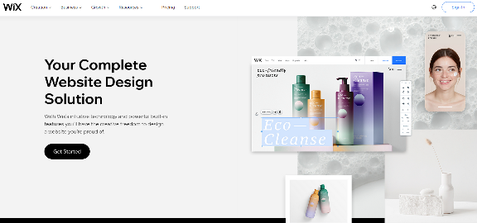
Unit 1. Online content creation. Taking your business online.
1.2 Website / blog / online store
Website: WIX https://www.wix.com/
Wix is the World's largest website builder, with more than 100 million users. Its secret is a flexible and easy system for creating websites. The best feature is the number of designs available to use for free.

Slide 8
Unit 1. Online content creation. Taking your business online.
1.2 Website / blog / online store
Wix offers three design options, all of which are simple and accessible.
Open design
Custom design based on questions about your business.
Templates.
Below we will show the templates design option.
The Deal Farm website. Created in one hour without IT skills.

Slide 9
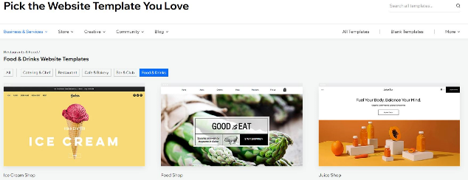
Unit 1. Online content creation. Taking your business online.
1.2 Website / blog / online store
Select a template adapted to your business

Slide 10
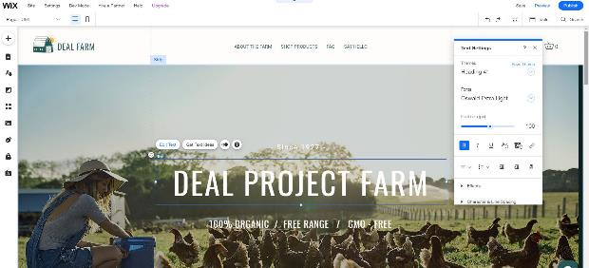
Unit 1. Online content creation. Taking your business online.
1.2 Website / blog / online store
Choose the design you like and edit the website
All texts and menus can be modified by simply clicking on them.
You can intuitively upload your logo and photos.

Slide 11
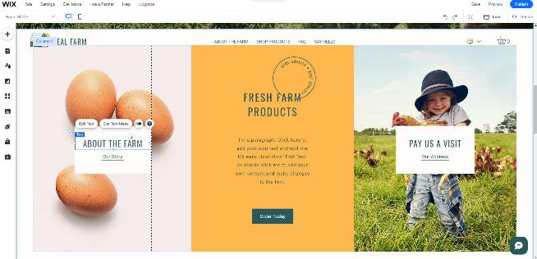
Unit 1. Online content creation. Taking your business online.
1.2 Website / blog / online store
The template includes all the standard sections of the chosen activity.
You can add new sections easily.

Slide 12
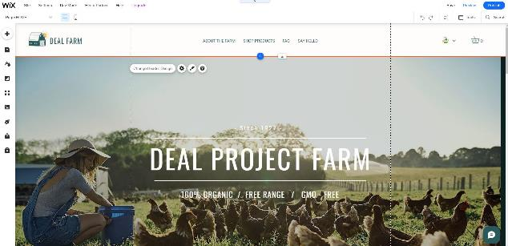
Unit 1. Online content creation. Taking your business online.
1.2 Website / blog / online store
You have a save option so that you do not lose track of where you are.
At any time you can check how your design is progressing with the Preview option.
When everything is ready you just have to click the publish button to publish your site.
Now you have a website!

Slide 13
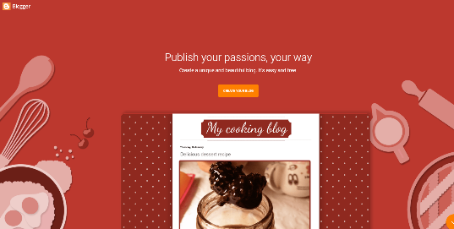
Unit 1. Online content creation. Taking your business online.
1.2 Website / blog / online store
Blog: Blogger https://www.blogger.com/
As they state on their homepage "Create a unique and beautiful blog. It's easy and free".
No coding or programming knowledge is required, you just need imagination and enthusiasm.
A blog is a perfect partner for your website or social media profiles.

Slide 14
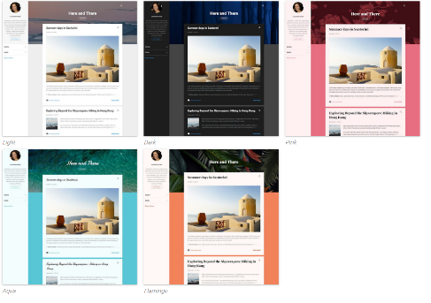
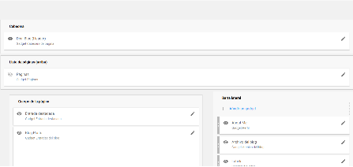
Unit 1. Online content creation. Taking your business online.
1.2 Website / blog / online store
You can select a template or design your blog yourself. It is simple and is done in a couple of steps.

Slide 15
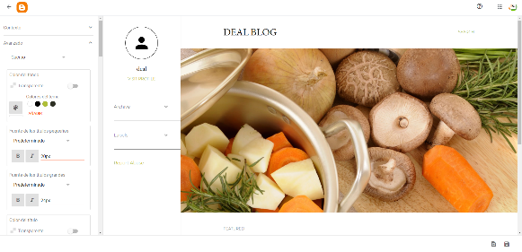
Unit 1. Online content creation. Taking your business online.
1.2 Website / blog / online store
You can easily customise the images, texts, add your logo, social networks, etc.

Slide 16
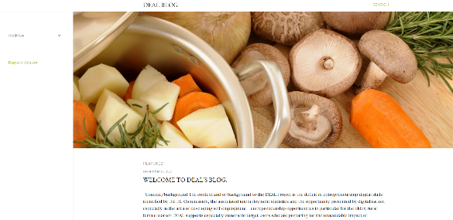
Unit 1. Online content creation. Taking your business online.
1.2 Website / blog / online store
You will be posting blogs in a few minutes.

Slide 17
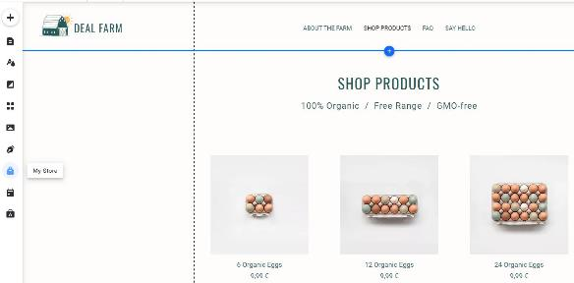
Unit 1. Online content creation. Taking your business online.
1.2 Website / blog / online store
Online store: WIX https://www.wix.com/
For your first online shop Wix is also an accessible and intuitive solution.
Back to your farm, just click on My Store to have a fully configured online shop.

Slide 18
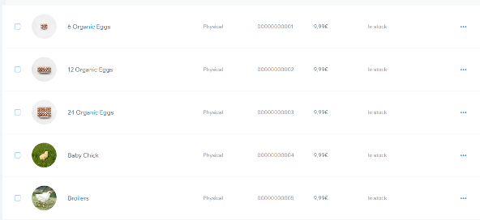
Unit 1. Online content creation. Taking your business online.
1.2 Website / blog / online store
Ready to enter product information, prices, payments, etc.

Slide 19
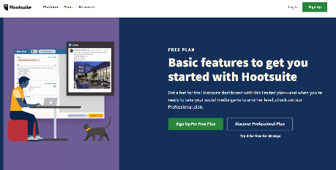
Unit 1. Online content creation. Taking your business online.
1.3. Social media.
We all have social networks, and we know how to create profiles and their basic configuration. Whether we want to be influencers or simple users or we intend to use our corporate social networks professionally, these are some of the best free options to manage social networks:
Social media management and analytics: HootSuite. https://hootsuite.com
The free version is a great starting point.
It will help you manage up to two social media accounts.

Slide 20
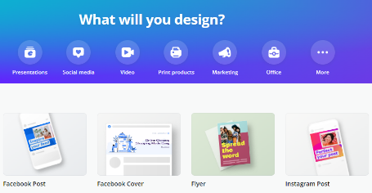
Unit 1. Online content creation. Taking your business online.
1.3. Social media.
Professional design for social networks: Canva. https://www.canva.com/
This is the best known and most used tool to create designs for social networks in a very intuitive way.
It has a very easy-to-use interface and offers a wide variety of resources such as images, templates, typographies, stickers, etc.

Slide 21
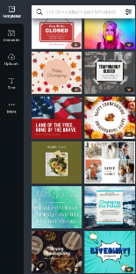
Unit 1. Online content creation. Taking your business online.
1.3. Social media.
Working with free templates you can create a professional Facebook or Instagram post in 3 easy steps.
1. Select a template related to the topic of your post.

Slide 22
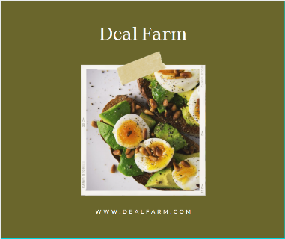
Unit 1. Online content creation. Taking your business online.
1.3. Social media.
3. Publish the post
2. Edit the content (images, colors, and text) by just clicking on the elements.

Slide 23
Unit 2. Social media strategy
2.1 How to develop a media strategy
Identify your goals. Don´t forget to set measurable goals.
Research and identify your target audience. Learn everything you can about them.
Learn about your competence strategy. Imitate what works.
Create a social media calendar
Be creative, as you know, you can use free and user friendly tools to improve your publications.

Slide 24
Unit 2. Social media strategy
2.2 Choosing the best format.
Blog posts: These publications showcase your company's knowledge and expertise, which can help you increase your credibility and reputation. Blog posts are easy to produce and effective at boosting SEO.
Social media posts: The fastest and straightforward way to reach out to your followers. Excellent content can go viral and attract new followers and customers.
Video: Thanks to smartphones, shooting videos has never been easier. Facebook's algorithm prioritises them, and they can be a fun way to showcase your products.

Slide 25
Unit 2. Social media strategy
2.2 Choosing the best format.
Infographics: Great for representing data in an easy-to-understand format. Infographics are a popular content format for sharing on social media.
Images: Good images increase engagement and make your customers appreciate your brand. On the internet you can find free high-quality image banks.
Comments and reviews: Opinions and reviews are valuable because people trust them. They can be useful for your business. You must be prepared to manage and accept criticism.

Slide 26
Unit 2. Social media strategy
2.3 Choosing the best channels.
Blog posts: The best channel is your own blog. In this unit, you have learned how to create it easily and for free. To boost its effectiveness, you should publish reviews on your social networks and link them to each post.
Social media posts: Facebook and Instagram will be your main partners. Tools like Canva will give a highly professional look to your publications.
Videos: On Facebook and Instagram, you can easily post videos related to your products or services. Another free and very simple option is to create your YouTube channel.

Slide 27
Unit 2. Social media strategy
2.3 Choosing the best channels.
Infographics: Facebook and Linkedin are excellent options for infographics. Twitter is an alternative option.
Images: The best options for posting images are Instagram and Pinterest, which you can combine with Facebook posts.
Comments and reviews: Comments and reviews work well on Facebook and LinkedIn. Facebook even has star ratings integrated into company pages.

Slide 28
Thank you!

